Slide 1
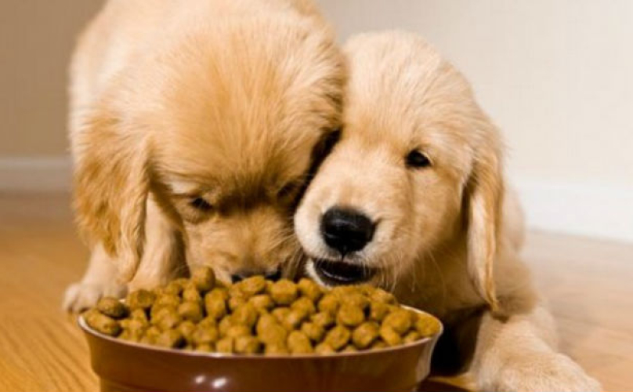
Pet foods.
Basic introduction.

Slide 2



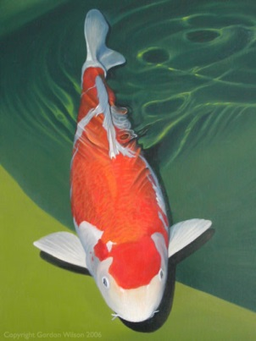
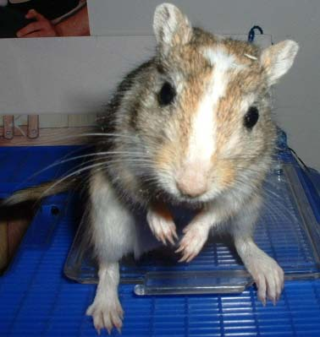
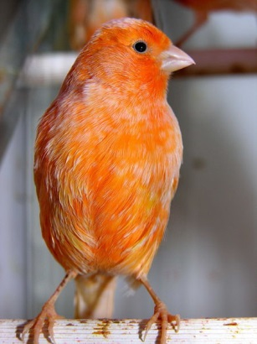
Petfoods – Understanding.
Food for pet animals living in close proximity with human
Dog food, cat food, aquarium and pond feeds, food for cage animals and birds
Pet animals have status of friend or family member with great sentimental value
Require nutritionally balanced diets
Sustaining an animals health over long period
Price is not most important criteria
Health aspect and subjective appearance to owner (buyer) is most important

Slide 3
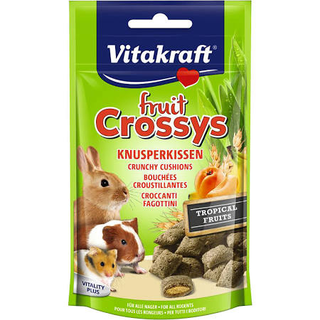
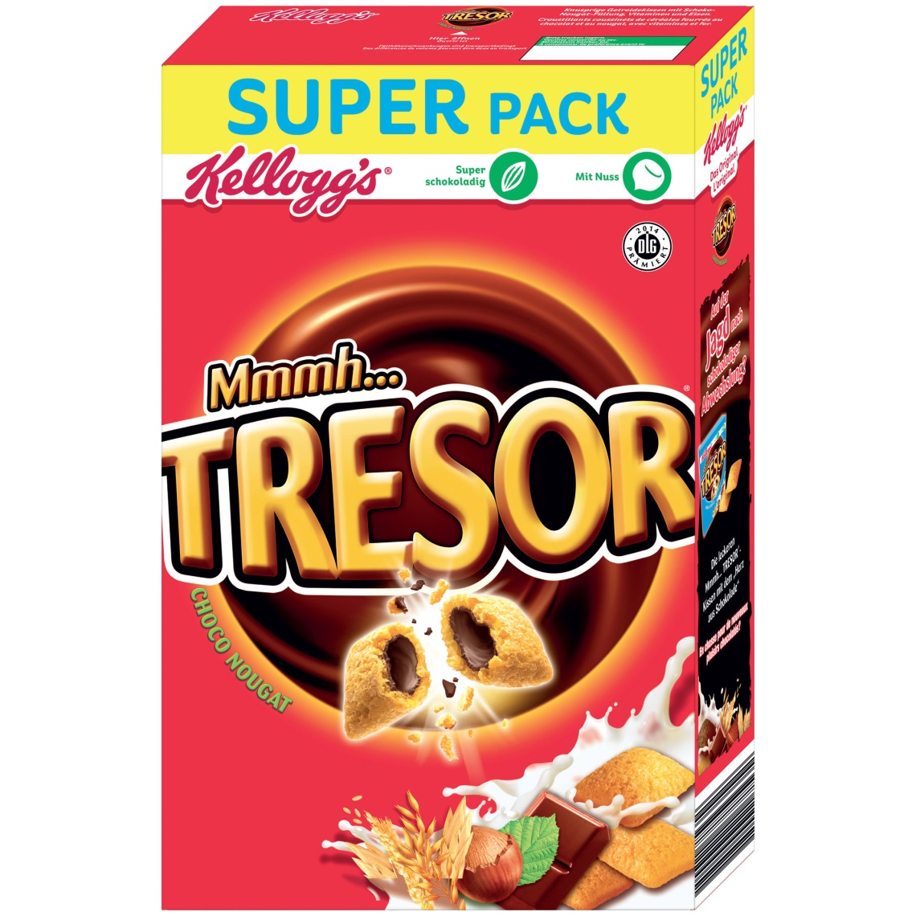
Pet foods vs. Packed RTE Foods.
41.00 CHF/kg
10.60 CHF/kg

Slide 4
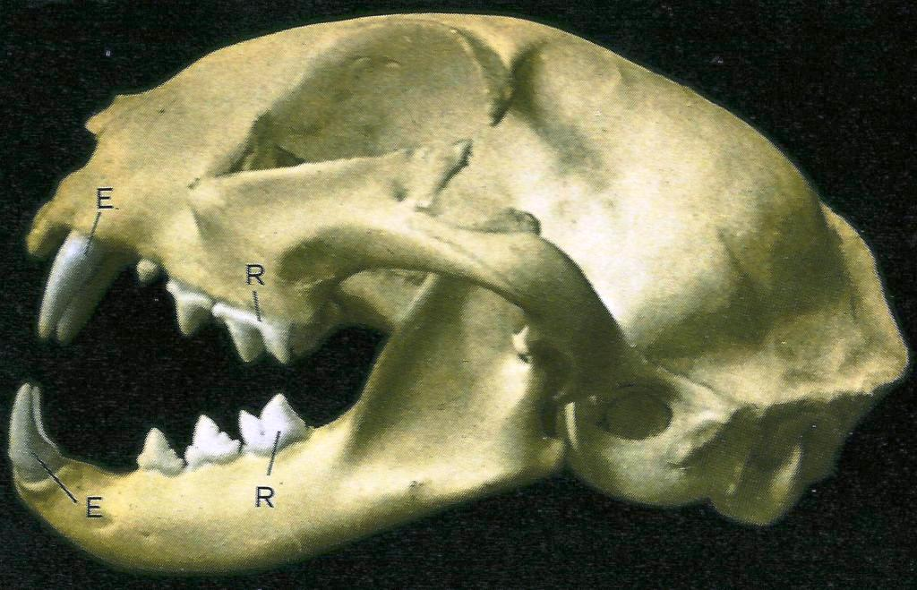
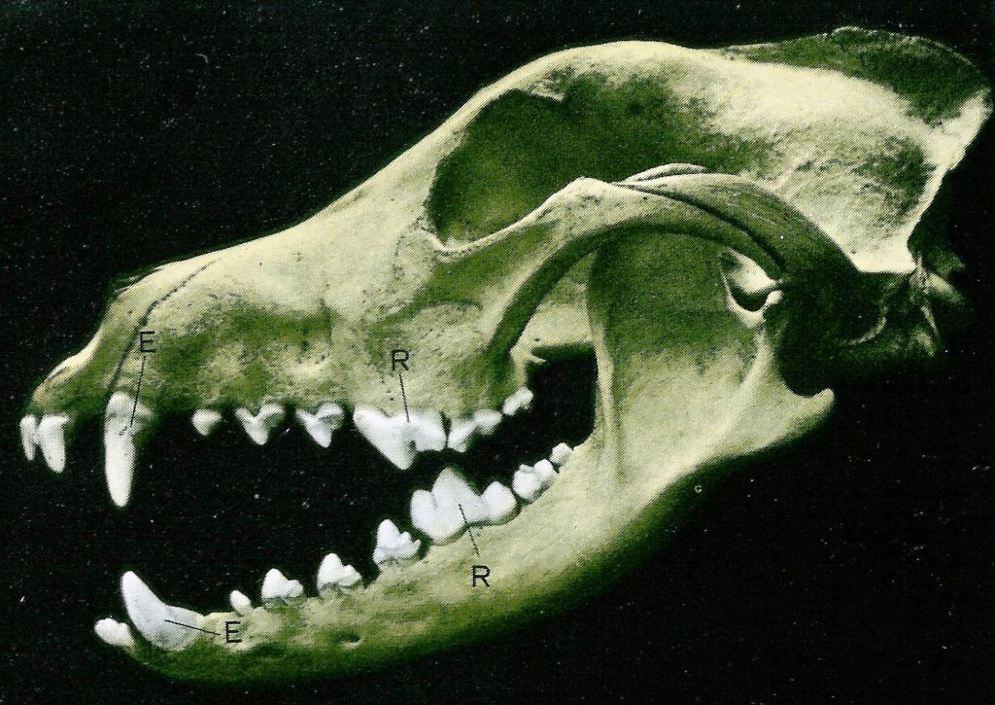
Cats and dogs, dentition.
Cats
distinct carnivore dentition
with large canines
and powerful carnassials
→ hunting animal
→ difficulties in balancing and grinding small, hard, round, dry petfoods
→ prefere soft, chewy, meaty textures
Dogs
have carnassials and premolars
→ hunting animal, omnivore preferences
→ can chew and grind dry petfoods prior to ingestion
inscisors
carnassials
canines
premolars

Slide 5

Nutritional requirements – Dogs.
Omnivorous, oportunistic carnivorous scavengers
50-100 times as many scent receptors as human
Convert proteins into energy and muscle
But are also able to convert carbohydrate into energy
Can tolerate prolonged starvation, can mobilize own fat reserves
Need less proteins than cats

Slide 6
Petfoods – Dog food , nutritional declaration.
as advertised by European manufacturer 2007

Slide 7
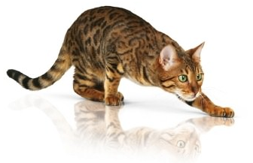
Nutritional requirements – Cats.
True obligate carnivore
10 times as many scent receptors as human
Needs animal protein to survive
need higher level of protein and fat to remain healthy
Require various meat derived nutrients
Starvation may lead to health disorder

Slide 8
Petfoods – Cat foods, nutritional declaration.
as advertised by European manufacturer 2007

Slide 9
Nutritional declaration in comparison.
as advertised by European manufacturer 2007

Slide 10
Petfood typical ingredients.
Cereals and cereal by-products
Whole cereals such as wheat, oat, corn or barley, wheat milling byproduct meals, broken rice, etc.
Meat and meat by-product meal, fish meal
a large variety of byproducts from the meat and fish processing industry
Vegetable proteins
Corn gluten meal, soy bean meal, sunflower press cake, wheat gluten, pea protein, etc.
Animal and vegetable oils
Beef and poultry fats from animal rendering and from the vegetable oil industry, whole oil seeds, etc.
Functional ingredients
Dietary fibers for bowel conditioning, humectants and sugars for regulation of water activity, mineral and organic acids for pH correction
Flavors and Colors
Palatants such as hydrolyzed meat and meat byproducts, natural and synthetic food colors
Vitamins, probiotics and minerals
Vitamin and mineral premixes, pre- and pro-biotics, enzymes, plant extracts, etc.

Slide 11
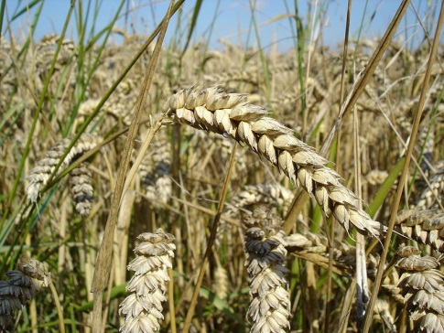
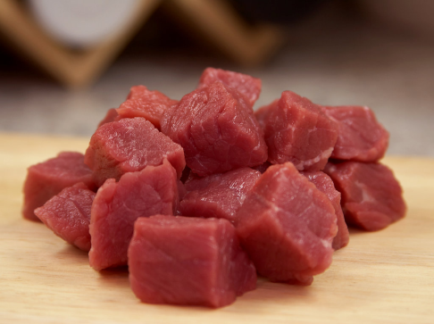
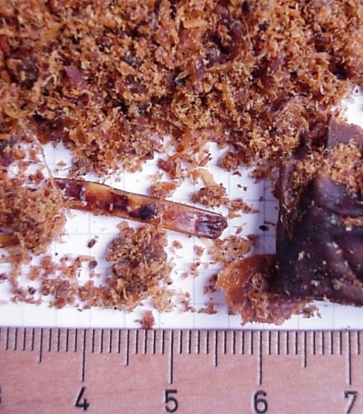
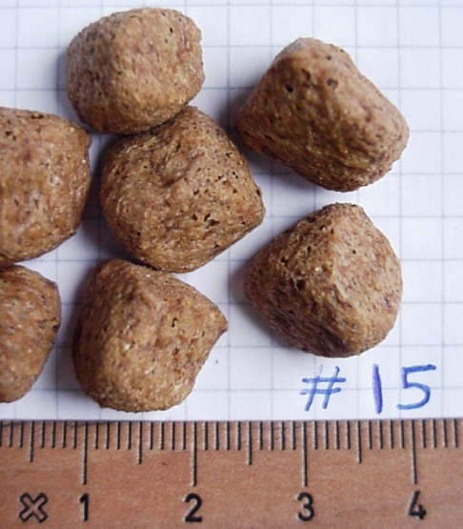
Powder to kibble – dissolution of ingredients.
Main components
Cereals or cereal byproducts
Meat and meat by-products
Fine grinding and dissolution of macromolecules by
thermo-mechanical extrusion process
Shaping and cutting into a specific shape upon
expanding through die plate
Example
High fat chicken byproduct meal directly from rendering plant, containing sinews, bones, beaks, etc., fat content 20-25%.
Picture showing same raw material but mixed with whole cereal grains, ground and extruded into dry expanded petfood kibble.

Slide 12
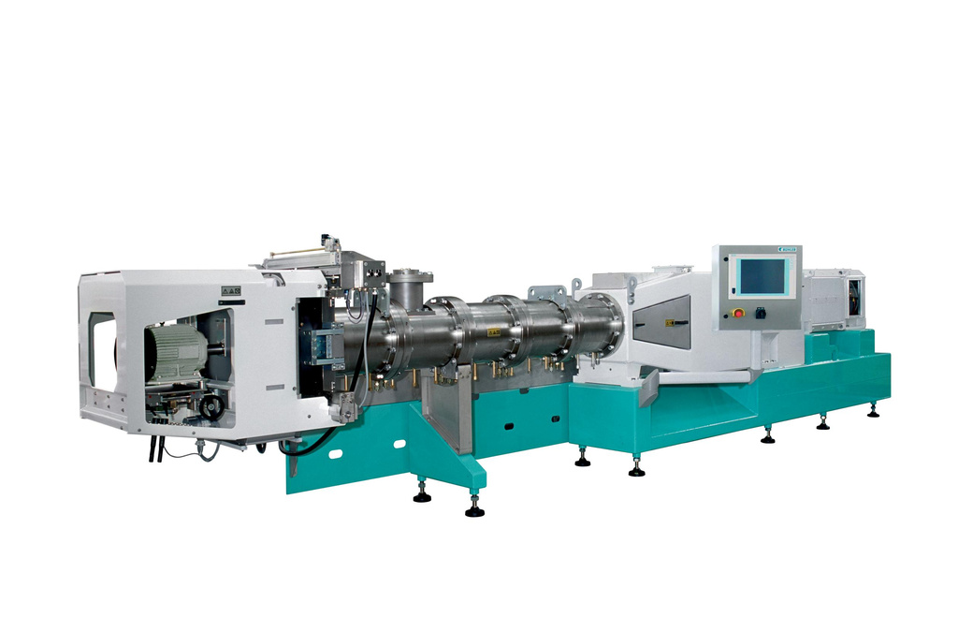
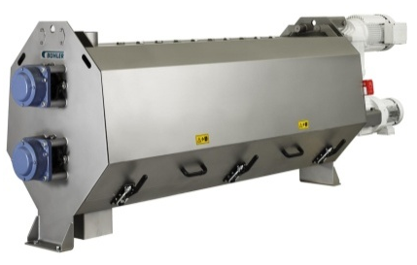
Overview Modules.
4. Barrels
5. Screw elements
3. Preconditioning
1. Main features
2. Drive
6. Cutter
11. Control unit
8. Heating / Cooling of Barrels
7. Screw extraction
9. Steamdosing
10. Waterdosing

Slide 13
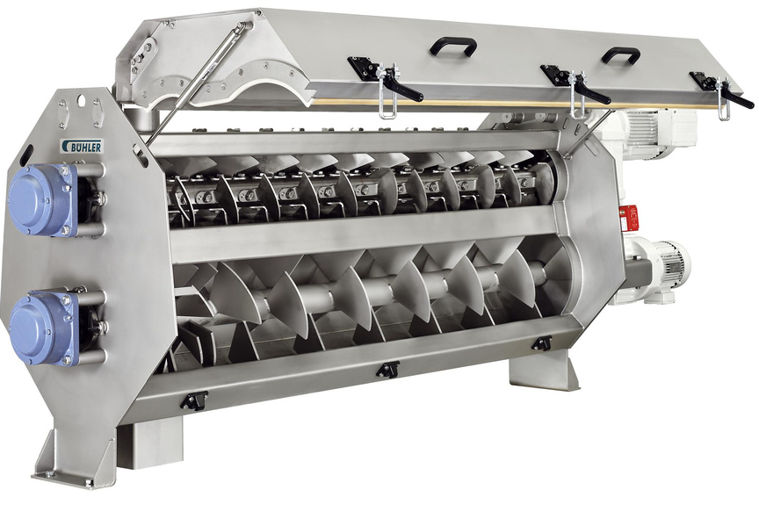
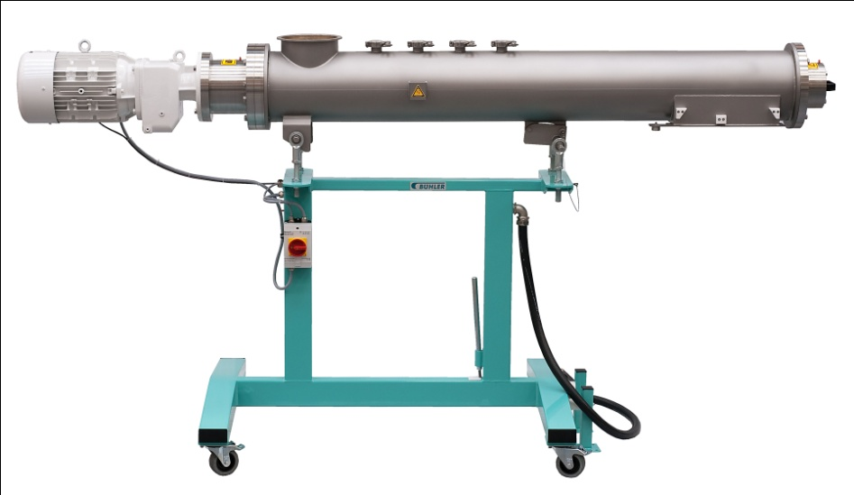
Preconditioning.
PolyTherm™
Compatible to:
  PolyTwin™
  PrioTwin™
Two stage design
Used with vertical stuffer
PrioTherm™
Compatible to:
  PolyTwin™
  PrioTwin™
One stage design
Mounted right on extruder inlet

Slide 14
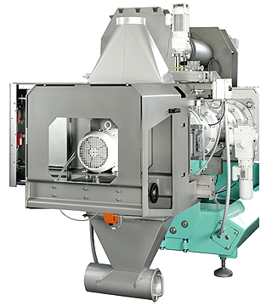
Cutter.
  More technical details:
  Sturdy and precise design for clean product cut and low wear on knives and die plates
  Cutting housing with hinged door for access to knives and cleaning
  Visual quality control
  Sample opening

Slide 15
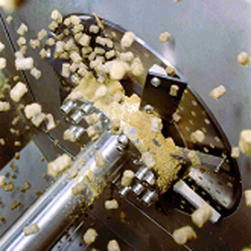
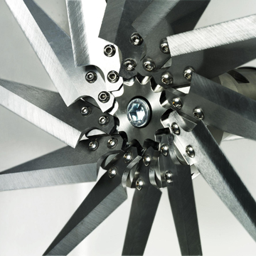
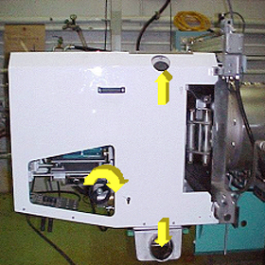
Cutter.
  Pneumatic-driven, lateral sliding, precisely aligned
  PolyTwin™ / PrioTwin™ / CompacTwin™ / EcoTwin™
  Knives adjustable during operation to keep constant product quality
  Quick change of knife head during extruder operation
  Quick die change
  International standards CE, GS, VUU
  Optional hot air flow through cutter box to prevent
  condensation.
  Customer benefits:
  Quick start-up
  Maximal production time, least down time
  Constant high product quality
  Easy to clean to keep sanitation
  Maximal productivity
  Automated operation
  Wide range of finished products
  Safe and secure operation

Slide 16
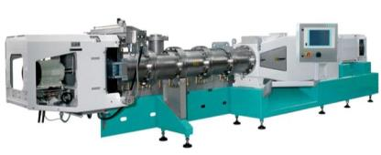
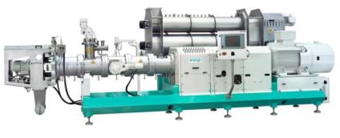
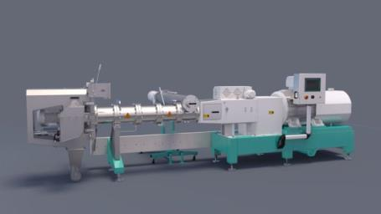
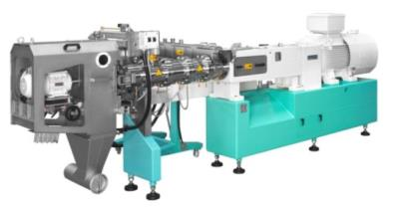
Nutrition Product Portfolio – Extruder in the focus.
Bühler’s Twin Screw Extruders.
Best Extruder
High Capacity
PolyTwin™
EcoTwin™
Lean Poly Twin
Perfor-mance Line
PrioTwin™
CompacTwin™

Slide 17
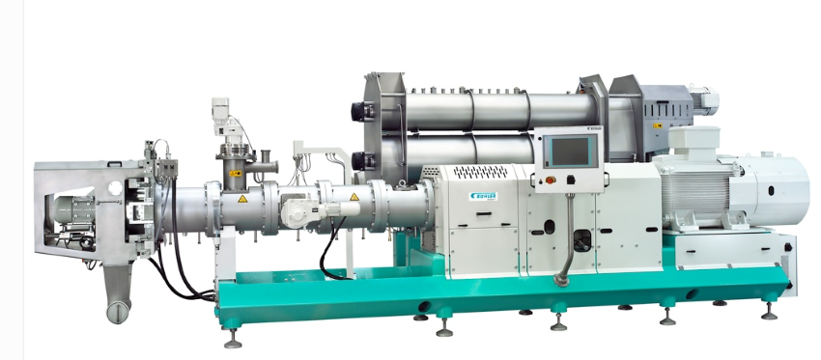
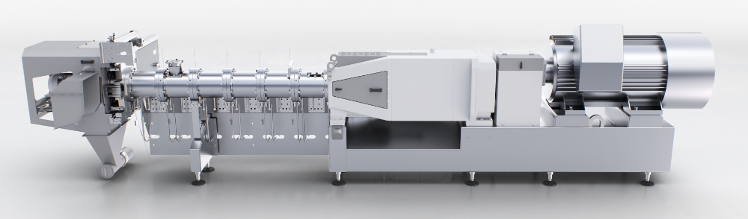
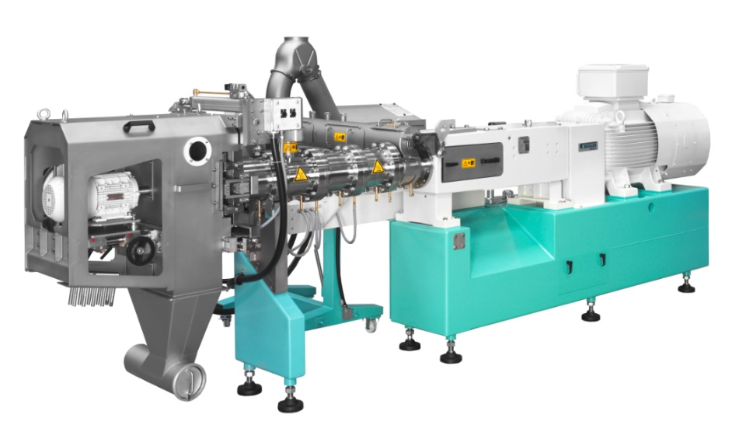
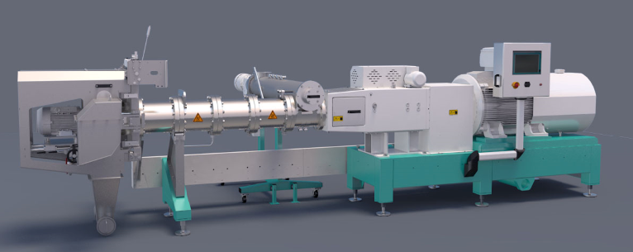
Nutrition Product Portfolio – Extruder in the focus!
Bühler’s Twin Screw Extruders. Alternativlayout
PolyTwin™
Best Extruder
EcoTwin™
Aquafeed High Capacity
PrioTwin™
Lean Poly
Twin
CompacTwin™
Top Quality made in China

Slide 18
Twin Screw Extruder Portfolio.
Status Quo.
BCTM
Ø 30mm
BCTL
Ø 42mm
BCTG
Ø 62mm
BCTF
Ø 93mm
BCTH
Ø 125mm
BCTJ
Ø 175mm
PiloTwin™
for pilot plant applications / low throughput / high flexibility
polyvalent
flexible
PolyTwin™
PrioTwin™
lower functionality “prio” features only
adapted to Petfood / Aquafeed Industry (pressure / torque)
similar to PRIO but suitable for higher capacities
EcoTwin™
Mid Market Extruder made in China
CompacTwin™
BCTM
Ø 30mm
BCTL
Ø 42mm
BCTG
Ø 62mm
BCTF
Ø 93mm
BCTH
Ø 125mm
BCTJ
Ø 175mm

Slide 19
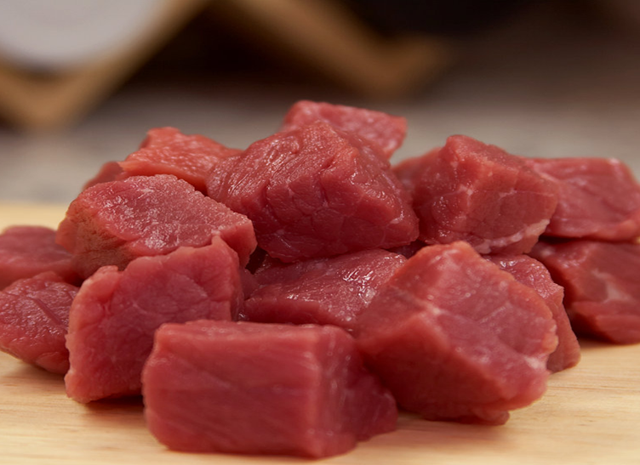
Premium Pet foods.

Slide 20
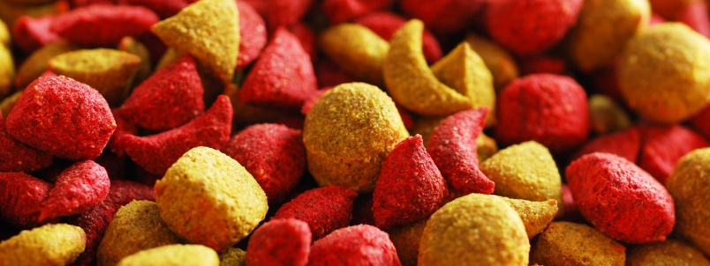

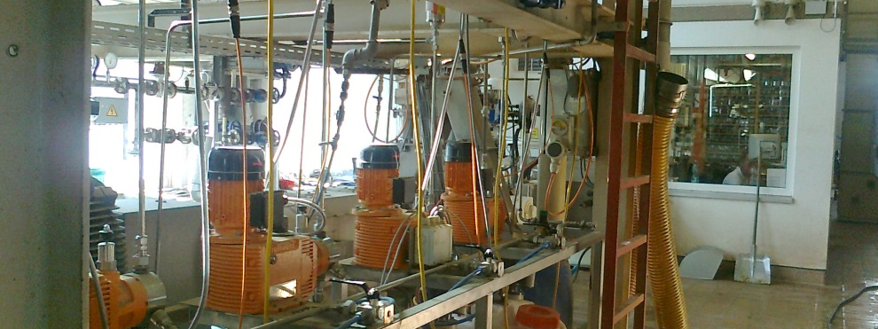
Multiple colored kibbles.
Consisting of:
  Low pressure dosing system for addition of color into venting section
Or alternatively:
  High pressure (piston type) dosing system for injection of color directly into working section
  Alternating color every 50-100s may yield a small percentage of mixed (impure) colors!

Slide 21
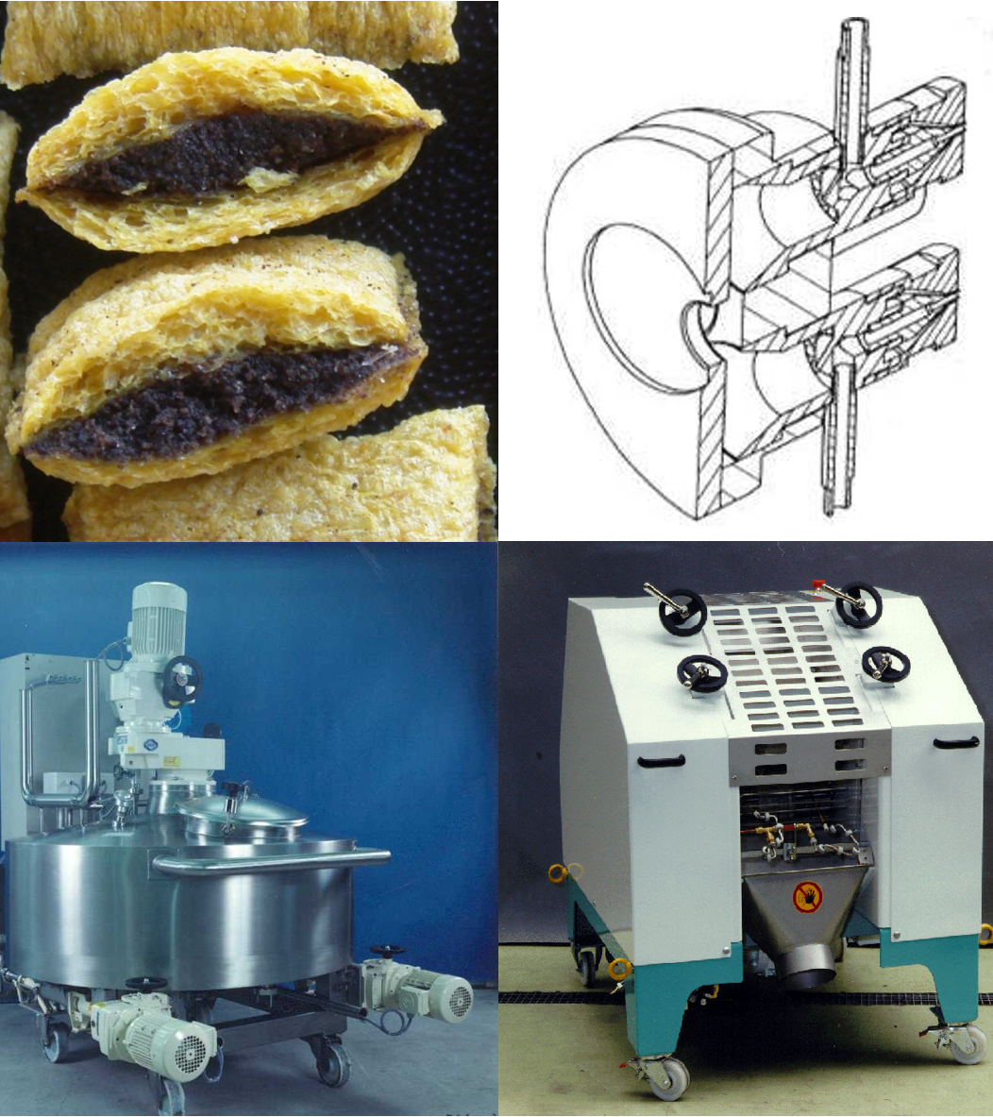
Equipment for co-extruded petfoods (filled pillows).
Consisting of:
  Coextrusion die
  (2-fold, 4-fold, 6-fold)
  Filling mass dosing system
  (2-fold, 4-fold, 6-fold)
  Pillow crimper with feeding belt
→ requiring ready made filling mass

Slide 22
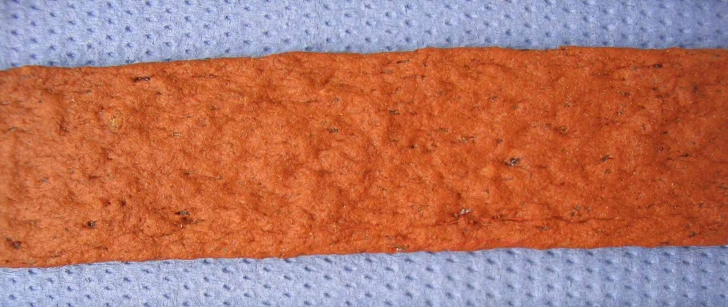
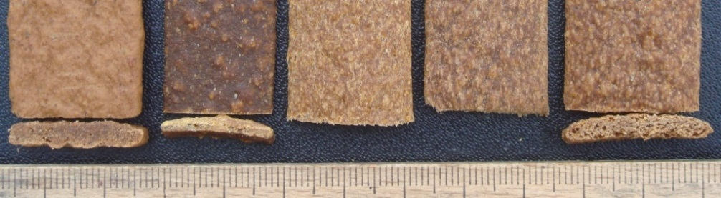
Equipment for semi-moist meat stripes.
Consisting of:
  Slot die with horizontal distribution
  Flash-off/ cooling belt
  Delayed cutting (guillotine type)
→ due to special shape products require additional surface
spraying and special handling device after cutting

Slide 23
Premium pet foods – process steps.
Intake, batching, grinding
Mixing
Micro ingredients
Extrusion
Coex, twisting, etc.
Drying
Cooling, delayed cutting
Coating, cooling
Surface coating
Sifting, Grading
Packaging
Individual packaging

Slide 24
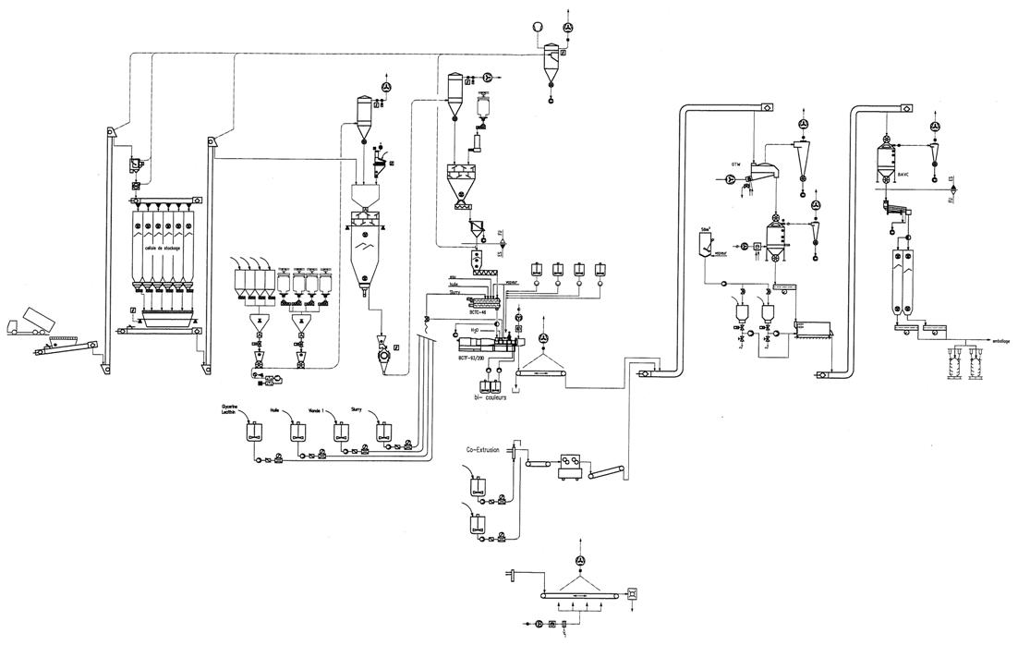
Premium pet foods – manufacturing process.
drying
cooling
extrusion
Intake, batching,
grinding, mixing
coating
sifting, bagging
Co-extrusion
Liquids, meat, humectants, etc.
cooling,
delayed cutting

Slide 25
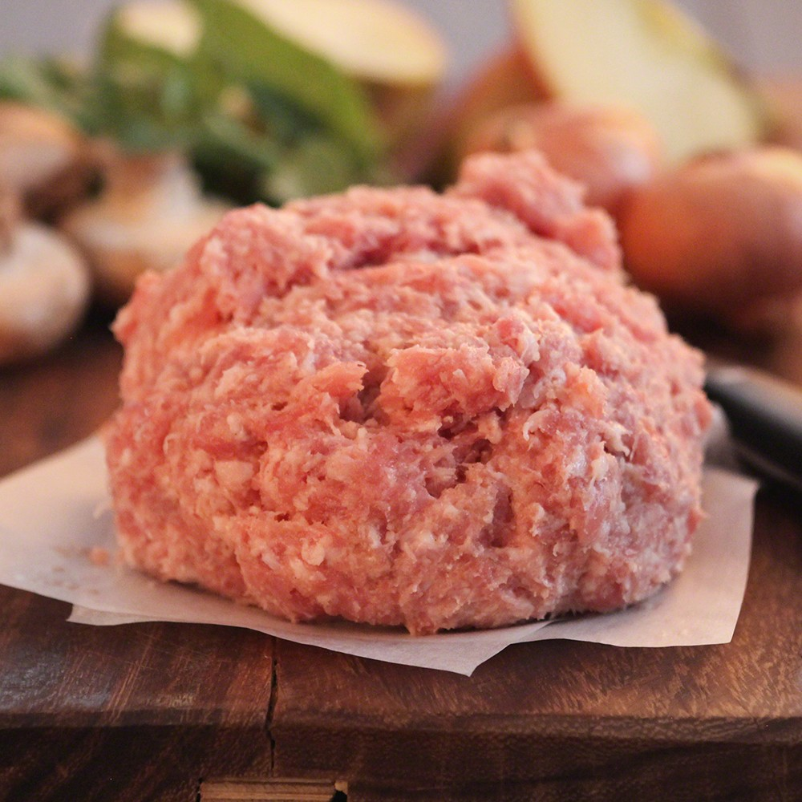
Extrusion Peripherals –
Meat feeding equipment.

Slide 26
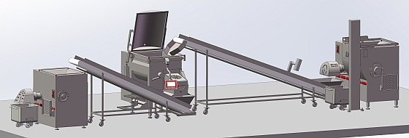
Meat Preparation – State of the art in meat industry.

Slide 27
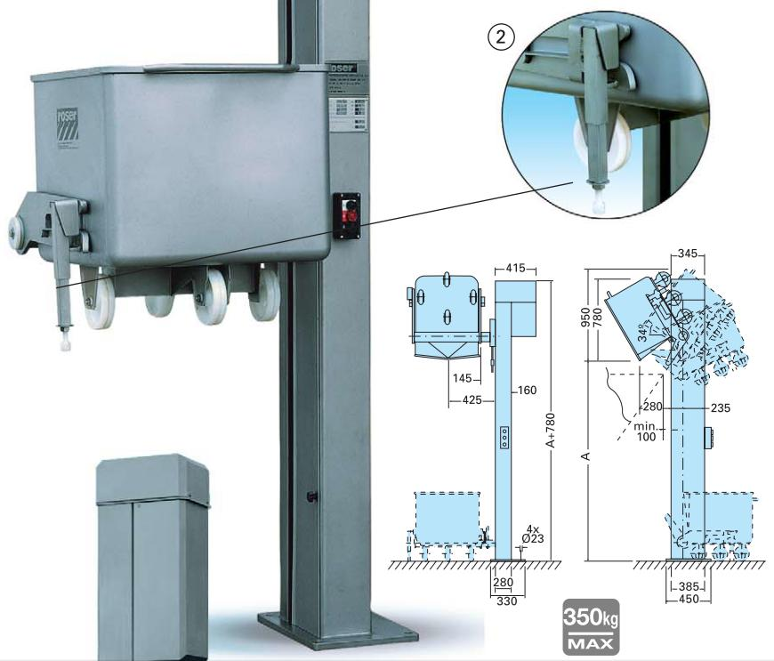
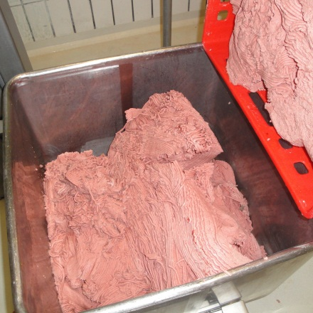
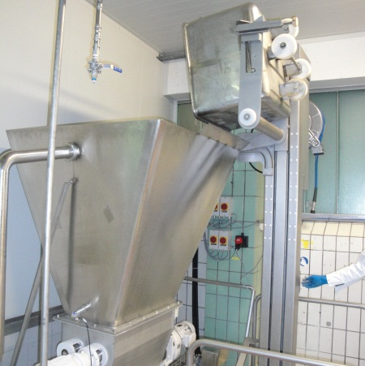
Example – container dumping hoist.
Lifts and dumps full containers into pump hopper

Slide 28
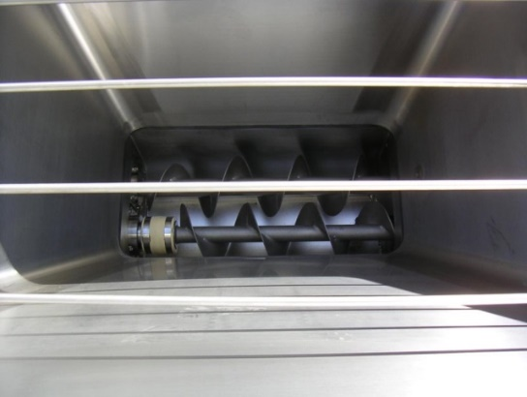
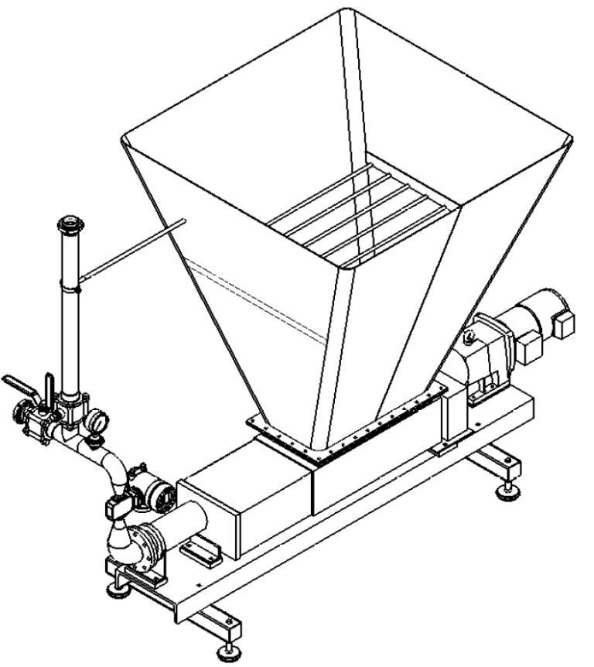
Meat feeding system.
  Meat ground to particles <2mm, must not contain long fibers or large chunks that can clog injection nozzles or flow meter orifice
  With large intake hoper allowing to add meat manually
  Eccentric screw pump with intake screw
  With additional agitator screw for improved intake
  With high level sensor for automatic refilling
  With safety grid at inlet
  Flow meter single tube, magnetic inductive with large orifice
  With recirculation tube for mixing of components and cleaning
  With large drain valve at bottom of pump

Slide 29
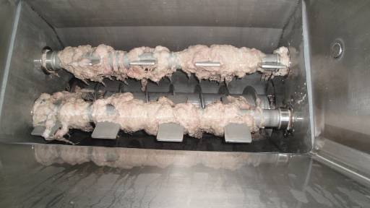
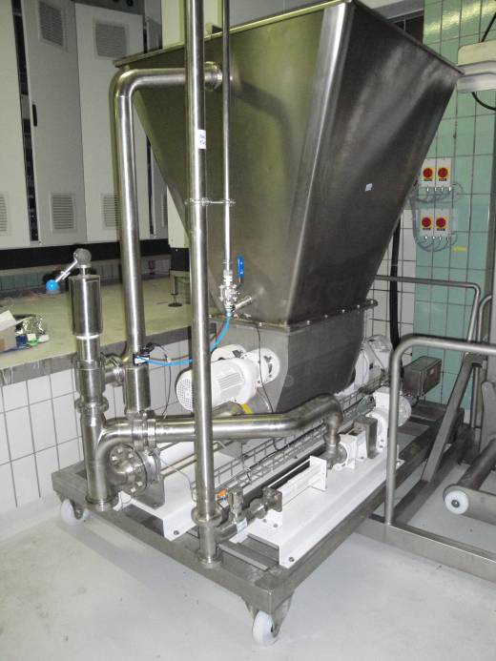
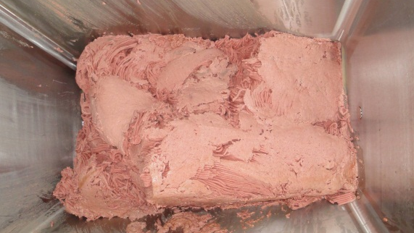
Meat dosing system – example two step dosing.
  Large low pressure pump with large intake hopper and agitators at bottom
  Combined with high pressure dosing pump

Slide 30
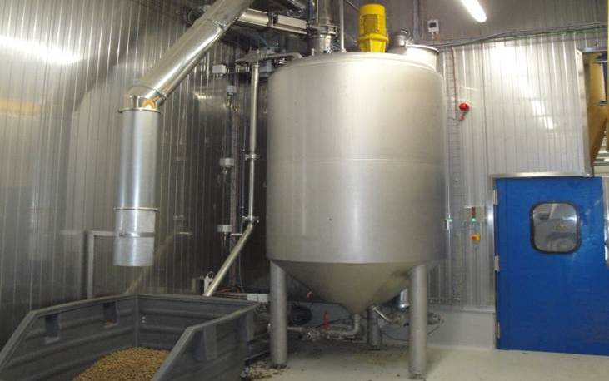
Extrusion Peripherals –
Slurry recycling system.

Slide 31
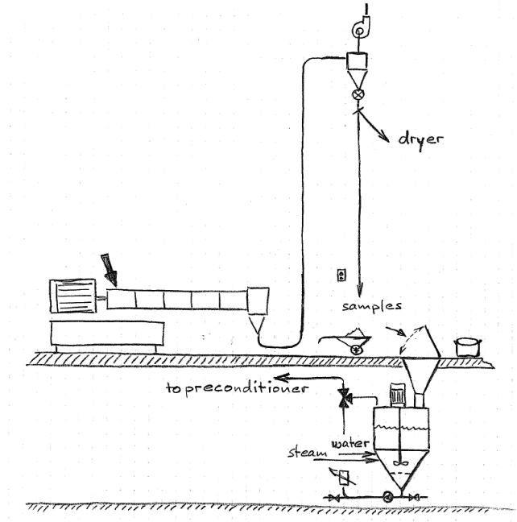
Slurry recycling system.
Starting procedure
Wash water and slurry is collected in container. When cutter is closed the first product will sucked to cyclone and comes back to the sampling port
The operator measures makes ensures right density and pellet quality and switches bypass valve to dryer
In emergencies extruder controller may also switch gate to bypass triggering sonic alarm
Operator to solve problem and if product is ok, he switches gate manually back to the dryer
Operator will manually dump off-spec product to slurry tank
Maximum solids content is usually less than 20%. Fluctuation in solids content has minor impact on the extrusion process.

Slide 32
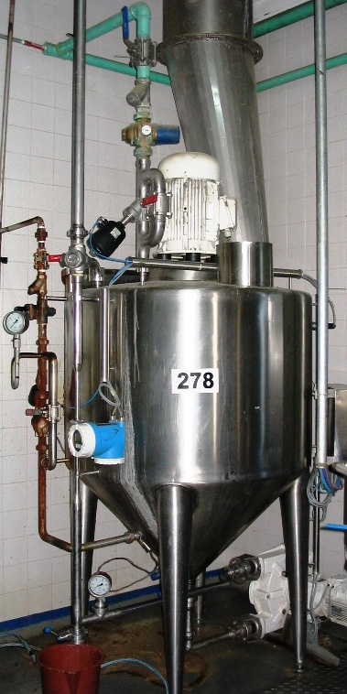
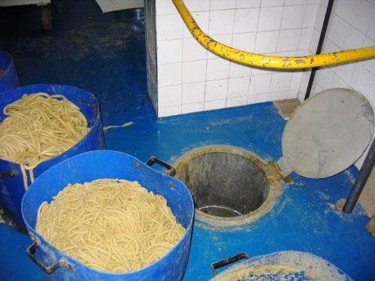
Slurry system.
Features
Automatic water addition maintaining water level
Thermostatically controlled live steam addition maintaining temperature at preset value, usually approx. 80°C
High speed mixer homogenizing content
Access port for ease of maintenance and sampling
3-way valve allowing to recycle tank content or to drain content of tubes back into tank for pasteurization
Peristaltic dosing pump for ease of replacing pumping tube

Slide 33

Slurry system – options.
slurry to extruder
Pneumatic shut-off valve at bottom of tank
Rotary piston pump instead of peristaltic pump for higher concentrations of slurry and for longer conveying distance
Pneumatic valves instead of manually operated 3-way valve for automatic recycling of slurry for preheating, draining or filling of tubes and for cleaning of line with steam
Gravimetric flow meter instead of magnetic inductive flow meter
Additional level sensor in middle of tank
fresh water
3
high level
high speed mixer
5
low level
4
grid
1
2
drains

Slide 34
Engineering Customer Success.
www.buhlergroup.com

